Slide 1
Predicting Wine Scores
Using price, region, and variety to predict what a wine critic will score a wine.
By: Adam Johnson
General Assembly DAT 2019

Slide 2
Defining The Problem
I’m the winemaker at Adam’s Vineyards and I want to make a new wine.
I want to make a wine that will have a high score from critics.
High scoring wine = high selling wine
What kind of wine do I make and where do I get the grapes to earn a high score?
Napa Cabernet Sauvignon -or- Italian Barolo

Slide 3
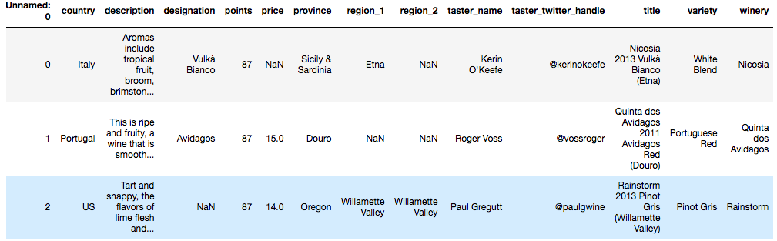
Wine Magazine Data with Critics Scores
~130,000 wines scored from all over the world
Scores (points) are on the scale of 80-100
Prices range from $4 - $3,300
Mean price $35, Mean points 88

Slide 4
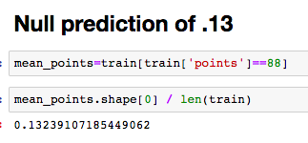
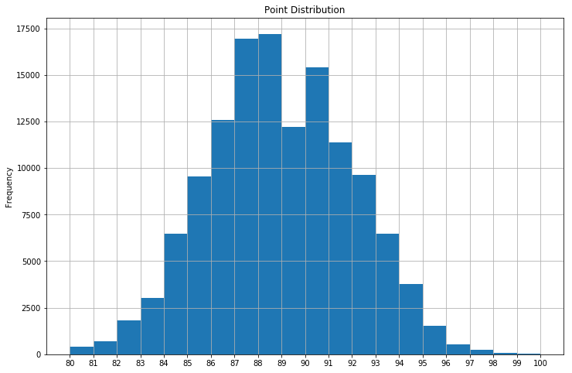
Finding the Null Prediction
I’d be right 13% of the time if I guessed the mean point value of 88 every time.
My model needs to predict scores better than 13% of the time.

Slide 5
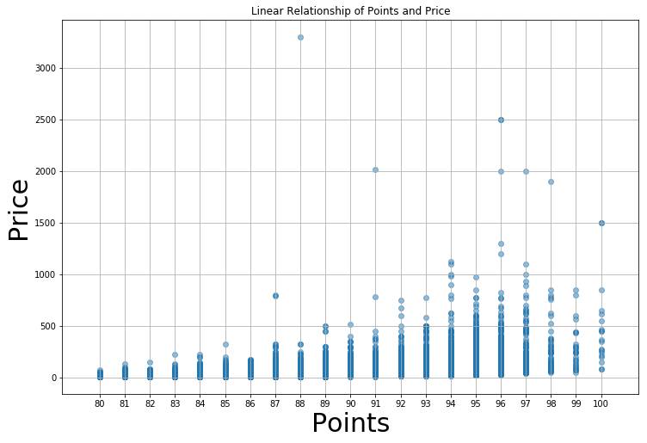
Price and Points Linearity
Price has the strongest linear relationship and correlation to Points.
I’ll use Price as a feature in most all linear models.

Slide 6
Price Modeling
Price ranges from $4 - $3,300 and has a mean of $35
Created Log_Price feature to normalize the distribution of pricing
Price had about 8,000 NaN values.
Instead of filling NaN values with the mean price of $35 I dropped all 8,000 NaN.

Slide 7
Preparing the Model
Predicting a point range of 80-100 is not perfect for the infinite values of linear regression, however it’s more appropriate than a logistic Y/N or 1/0 model.
Ridge Regression Model with Standard Scaler
Feature Selection:
Log_Price, Variety, Country, Province, Region

Slide 8
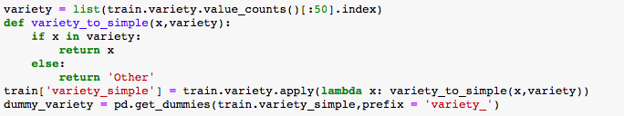
Dummy Columns for String Values
Variety, Country, Province, and Region are all string values that will need to be converted into Dummy Columns.
I filtered down the top value counts and converted to dummy columns with the remaining values with lower values counts labeled as ‘other’

Slide 9

DataFrame Building
After all the Dummy columns were built I concatenated each dummy frame with a placeholder frame containing Points and Log_Price
The DataFrame is now ready to model

Slide 10
Model Performance
After going thru Ridge Regression the model beat it’s Null Prediction of .13
R2 score was .43
Root Mean Square Error (RMSE) also beat the Null
Null RMSE: 3.04
Predicted RMSE: 2.47
The model would predict price with an average error of 2.47 points.

Slide 11
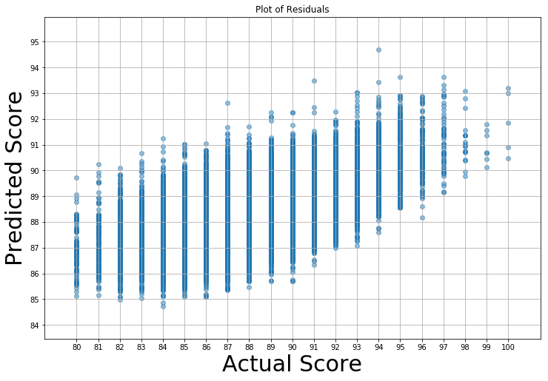
Plotting the Residuals

Slide 12
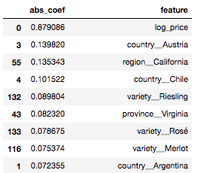
Improving Model Scores
The Regions model doesn’t have many obvious improvements to make in the way of feature tinkering. The coefficients were pretty evenly spread among features
Trying out an inherently bias model using Winery

Slide 13
Inherently Bias Winery Model
Using the same Ridge Regression model I changed the features to include
Log_Price and Dummy Winery columns
There are over 5,000 unique wineries in the dataset and I feature engineered all of them. My DataFrame was (120,000, 5,000). My computer nearly melted.
I dialed it back to 500 winery features (120,000, 500) to start. That scored .40
I dialed it up to 1,000 winery features (120,000, 1,000). That scored .43
I dialed it up to 2,000 winery features(120,000, 2,000). That scored .46
2,000 was about as much as my fragile CPU’s could handle.

Slide 14
Regions Model vs. Bias Winery Model
Regions Model R2 score: .43
Regions Model RMSE: 2.47
Bias Winery Model R2: .46 (at 2,000 wine features)
Bias Winery Model RMSE: 2.23 (at 2,000 wine features)
Given how close they are, I’m happy with the performance of the Regions Model

Slide 15
Model Evaluation
Regions Model was a success at R2 .43 and RMSE 2.47
As a winemaker at Adam’s Vineyards I feel confident that the wine I make will score within 2.47 points of the predicted score.
If we made a Walla Walla Syrah with a predicted score of 94 and at worst scores a 92. I’m happy with that

Slide 16
Takeaways
Low predictions can have high actuals.
I’m not stoked on a predicted score of 90. But there is potential to score 93-97 points on actuals.

